Slide 1
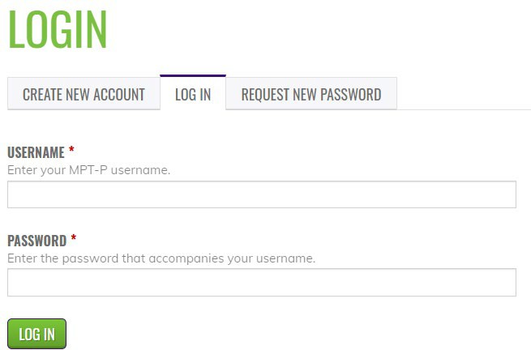
Credit Claim Information
Project TEACH –Children’s Mental Health Intensive Training
Fall 2024
Step 1: Login into Learning Management System: At https://lms.projectteachny.org
Click login then enter your username and password. If you have forgotten your password, please click the Request New Password button.
Step 2: Register to Course
https://lms.projectteachny.org/CITOct2024Anxiety
Click on the green ‘Take Course’ button.
Step 3: Select Take Course
a) Review Videos and Slides if desired
b) Select and complete the Evaluation ( if not completed previously)
c) Select Credit option to claim credit
d) Select Certificate option to get certificate

