Slide 1
Working with Anxiety
Practical skills for working with anxious youth in your practice
Nayla M. Khoury, MD
Jessica Grant, MD

Slide 2
Learning Objectives
Practice 3 strategies for working with anxious youth in your exam room: Fear Ladder, FEAR Plan, and Progressive Muscle Relaxation.
Discuss how to empower parents to work with their anxious youth.
Review additional resources to share with anxious youth and their families.

Slide 3
Why is this important?
Anxiety is prevalent (8-10% of kids), with typical presentation between 6-12 years of age.
Pediatricians are often the first to identify the anxious child.
There are barriers to seeing a therapist: time and money.
The meds we have can only do so much.
Early intervention for anxiety decreases the risk of development of an anxiety disorder.

Slide 4
Getting to know your anxiety
Labeling anxiety
Knowing healthy parts of anxiety
Learning unhealthy parts of anxiety
Subjective units of distress

Slide 5
CBT Goals
Goals of CBT treatment include all of the following except:
Psychoeducation
Teaching relaxation and coping skills
Helping family accommodate patient's anxiety
Practice approaching exposures

Slide 6
CBT Goals
Goals of CBT treatment include all of the following except:
Psychoeducation
Teaching relaxation and coping skills
Helping family accommodate patient's anxiety
Practice approaching exposures

Slide 7
Reminder of CBT Goals
Educate the patient and the parents
Teach self-soothing and somatic management
Identify and change maladaptive thinking
Increase proactive approach behavior (graduated EXPOSURE)
Extinguish avoidance behavior
Increase healthy problem-solving
Facilitate insight and self-efficacy
Solidify gains and promote generalization
Notes:
Review goals of CBT so audience sees this much of this is DOABLE in the pediatric office setting. This can be for children who do not need or are not ready for CBT in a therapist office or as a bridge until children get into standard CBT.

Slide 8
100% Accountability
Managing Anxious Children:
100% Accommodation
Distress
Acting out
Impairment
Distress
Acting out
Impairment
Notes:
First step in anxiety management is often to convince the parent that there is a need for intervention. They often have developed maladaptive means of managing anxiety.

Slide 9
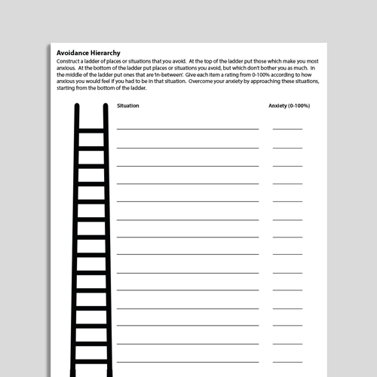
Fear Ladder: Graded Exposure
Build a separate ladder for each fear
Start with steps that cause mild anxiety and work towards steps that cause more anxiety
For middle steps consider length of time, environment, who is with you
-
Notes:
This can be developed in the pediatricians office.
Steps in the middle (not the low fear or the high fear goal but the in-between steps) can be hard to identify- vary factors such as length of time, envirorment, supports

Slide 10
Fear Ladder: Phobia of Needles
10 Get a shot
9 Slightly prick skin with a needle
8 Clear skin with alcohol pad (step prior to getting a needle)
7 Watch someone get a needle in real life
6 Rest a needle on your skin
5 Stick a needle into a doll
4 Hold a needle
3 Watch a needle be stuck into a doll
2 Watch video of someone getting a needle
1 Look at a picture of a needle
Notes:
This comes up in the pediatrician’s office all the time and is a great chance to open the door to an anxiety discussion

Slide 11
Fear Ladder: Social Anxiety
10 Sit in a restaurant and order meal alone
9 Call the waiter over to get the check
8 Ask for modifications or add additional parts to the meal
7 Sit in a restaurant and order the meal with family present
6 Sit in a restaurant and order water with family present
5 Sit in a restaurant and greet the waiter with eye contact
4 Sit in a restaurant while parent orders food
3 Practice ordering food with a parent in the kitchen
2 Practice ordering food at home alone
1 Look at a menu at home
Notes:
When asking about anxiety, I specifically ask about this as this will affect function later in life. Many adolescents consider it normal to not be able to order food or ask for help at a store, but when I draw this to their attention, they acknowledge this creates difficulties.

Slide 12
FEAR Plan
Feeling afraid? 0-10? Where in your body?
Expecting the worst? Thoughts?
Action: What can I do?
With my body?
With my mind?
With help of others?
Reinforce
What will help me to practice?

Slide 13
Progressive Muscle Relaxation
Two step technique: tension and relaxation
Pay attention to the feeling of relaxation when releasing the contracted muscle
Practice daily, bedtime is often ideal
Takes as little as 10 minutes per day to practice
Younger child: parent reads the script, can use fewer body parts
Can then utilize in other stressful situations

Slide 14
Relaxation Script Grades K-4 (Ollendick, 1978)
To begin the relaxation session, have the children sit comfortable in their chair and close their eyes. Soft, slow music can be playing in the background. When reading the script, speak in a soft, even tone. Pause between sentences.
Hands and Arms
Pretend you have a whole lemon in your left hand. Now squeeze all the juice out. Feel the tightness in your hand and arm as you squeeze. Now drop the lemon. Notice how your muscles feel when they are relaxed. Take another lemon and squeeze it. Try to squeeze. Try to squeeze it harder than you did the first one. That's right. Real hard. Now drop your lemon and relax. See how much better your hand and arm feel when they are relaxed. Once again, take a lemon in your left hand and squeeze all the juice out. Don't leave a single drop. Squeeze hard. Now relax and let the lemon fall from your hand. (repeat this process with the right hand and arm.)
Arms and Shoulders
Pretend you are a furry, lazy cat. You want to stretch. Stretch your arms out in front of you. Place them up high over your head, way back. Feel the pull in your shoulders. Stretch higher. Now just let your arms drop back to your side. Okay, kittens, let's stretch again. Stretch your arms out in front of you. Raise them over your head. Put them back, way back. Pull hard. Now let them drop quickly. This time let's have a great big stretch. Try to touch the ceiling. Stretch your arms way out in front of you. Raise them way up high over your head. Push them way, way back. Notice the tension and pull in your arms and shoulders. Hold tight now. Great. Let them drop very quickly and feel how good it is to be relaxed. It feels good and warm and lazy.

Slide 15
Muscle Relaxation: Script Conclusion
Stay as relaxed as you can.
Let your whole body go limp and feel all your muscles relaxed.
As you go through the day, remember how good it feels to be relaxed.
Sometimes you have to make yourself tighter before you can be relaxed, just as we did in these exercises.
Practice these exercises every night to get more relaxed.
When you are a really good relaxer, you can help yourself relax at school.
Just remember the turtle, or the jawbreaker, or the mud puddle, and you can do these exercises and nobody will know.
You've done a good job. You're going to be a super relaxer.

Slide 16
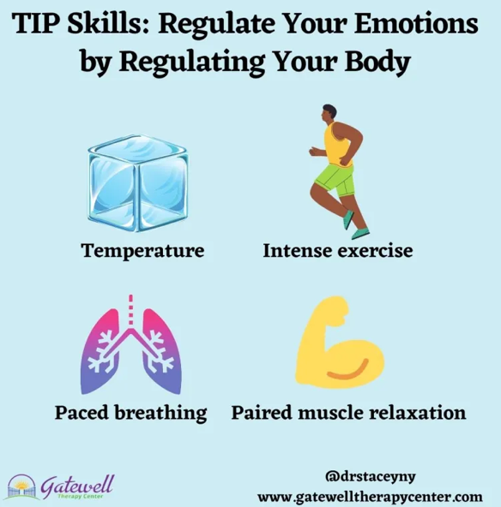
TIP Skills
Temperature
Intense Exercise
Paced breathing

Slide 17
Square Breathing

Slide 18
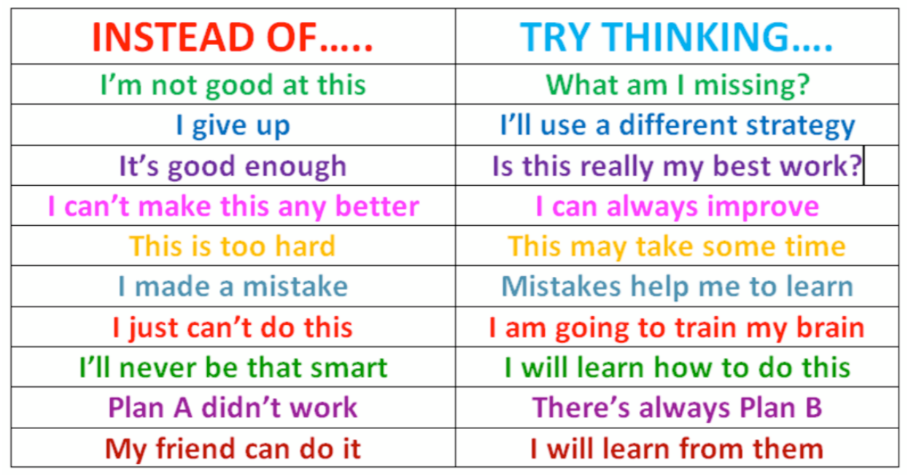
Thinking through negative thoughts
What thought might be more helpful?

Slide 19
Sleep Hygiene
Wind down period before bed
Consistent bedtime schedule
Physical activity during the day
Limit caffeine and alcohol
Create restful environment
Nothing but sleep on the bed
No napping
No screens in the room
Manage stress before bed
If unable to sleep:
Change position
Read for 20 minutes
Muscle relaxation
Can do short trial of melatonin
Notes:
Anxiety and sleep difficulties often go hand in hand...
If we can help sleep, we can help anxiety. If we can help anxiety, we can help sleep. Rarely do children have “insomnia”, they have anxiety.

Slide 20
Resources: Books
Chansky, Tamar. Freeing Your Child from Anxiety: Powerful, Practical Solutions to Overcome Your Child’s Fears, Worries, and Phobias.
Wagner, Aureen. Worried No More: Help and Hope for Anxious Children. 2005 (parents, with much on school refusal)
Huebner, Dawn. What to Do When You Worry Too Much: A Kid’s Guide to Overcoming Anxiety. 2005 (6-12 yo)
Huebner, Dawn. Outsmarting Worry: An Older Kid's Guide to Managing Anxiety. 2017 (9-13 yo)
Eli Lebowitz. Breaking Free of Childhood Anxiety and OCD. 2021.
Notes:
Breaking Free of Anxiety and OCD - Jessica can add this one.

Slide 21
Resources: Apps
Smiling Minds https://www.smilingmind.com.au/smiling-mind-app
Headspace https://www.headspace.com
Calm (Kids) https://www.calm.com/app/kids
Mindshift 12+ https://www.anxietycanada.com/resources/mindshift-cbt/
My Anxiety Plan for Children and Teens https://maps.anxietycanada.com/courses/anxiety-plan-children-teens/
Insight Timer https://insighttimer.com
Stop, Breathe and Think https://au.reachout.com/tools-and-apps/stop-breathe-and-think

Slide 22
More Apps
Relaxation
BellyBio (10+)
Mindful powers (up to 8)
CBT skills
Whats up? (13+)
CBT thought diary (12+)
Coping
365 Gratitude (13+)
Virtual Hopebox
Sleep hygeine
CBT-I coach (12+)
Safety
Notok

Slide 23
Resources: Websites
Anxiety Disorders Association of America (ADAA): www.adaa.org
The Massachusetts General Hospital Clay Center for Young Healthy Minds. http://www.mghclaycenter.org
Center for Clinical Interventions (Australia) Panic resources https://www.cci.health.wa.gov.au/Resources/Looking-After-Yourself/Panic
Child Mind Institute. http://childmind.org
CBT4Anxiety http://cbt4panic.org/wp-content/uploads/2017/08/BlankWorksheets.pdf
Roslindale Pediatrics handouts (BCH) https://roslindalepediatrics.org/news/anxiety-handouts
Worry Wise Kids worrywisekids.org

Slide 24
Take-aways
Early intervention with anxiety makes a difference.
The pediatrician has a unique opportunity to identify anxious children.
The pediatrician’s office is an ideal setting to start treatment for anxiety and can do so in brief intervals.
Tools for management of anxiety can empower children and their parents.

