Slide 1
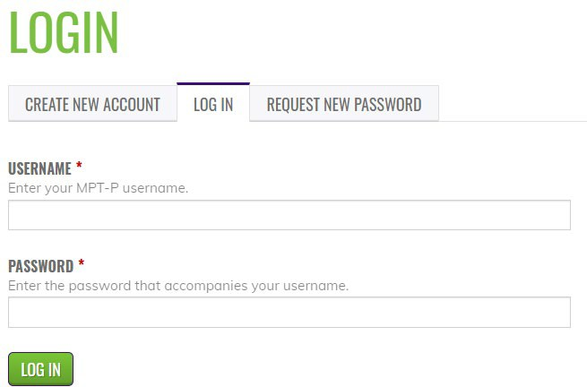
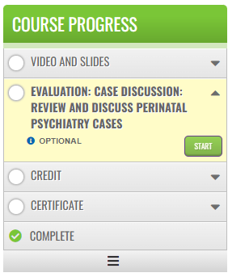
Credit Claim Information
Project TEACH –Children’s Mental Health Follow Up Session 4
Detection and treatment of perinatal anxiety disorder
Step 1: Login into Learning Management System : At https://lms.projectteachny.org
Click login then enter your username and password. If you have forgotten your password, please click the Request New Password button.
Step 2: Register to Course
https://lms.projectteachny.org/CMHFall2023FollowUp4
click on the green ‘Take Course’ button.
Step 3: Select Take Course
a) Review Videos and Slides if desired
b) Select and complete the Evaluation ( if not completed previously)
c) Select Credit option to claim credit
d) Select Certificate option to get certificate

